Slide 1
Chapter 10
Phase Transformations
Heat Treatment (time and temperature) ⇒
⇒ Microstructure ⇒ Mechanical Properties
Kinetics of phase transformations
Multiphase Transformations
Phase transformations in Fe-C alloys
Isothermal Transformation Diagrams
Mechanical Behavior
Tempered Martensite

Slide 2
Phase transformations: Kinetics
(kinetics ⇒ time dependence)
Three categories
Diffusion-dependent with no change in composition or number of phases present (melting/solidification of pure metal, allotropic transformations, recrystallization)
Diffusion-dependent but changes in composition or number of phase
( eutectoid transformations)
Diffusionless → metastable phase by small displacements of atoms in structure
(martensitic transformation)

Slide 3
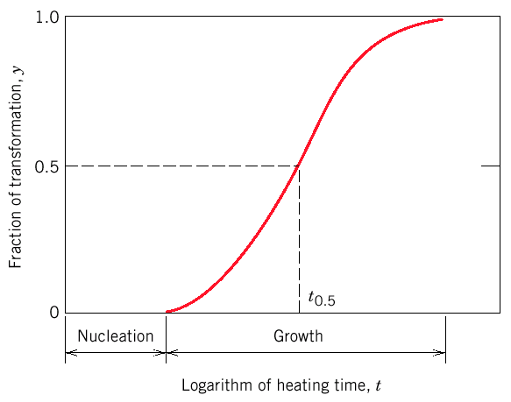
Phase transformation involves:
Nucleation - formation of small particles (nuclei) of the new phase. Often formed at grain boundaries.
Growth of new phase at the expense of the original phase.
S-shape curve: percent of material transformed vs. the logarithm of time.

Slide 4
Solidification: Nucleation Processes
Homogeneous nucleation
  nuclei form in the bulk of liquid metal
  requires supercooling (typically 80-300°C max)
Heterogeneous nucleation
  much easier since stable “nucleus” is already present
    Could be wall of mold or impurities in the liquid phase
  allows solidification with only 0.1-10ºC supercooling

Slide 5
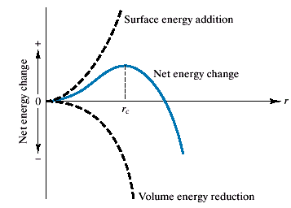
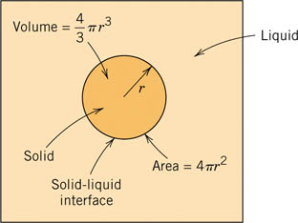
Nucleation
Energy =surface + volume
Nuclei are stable if growth reduces its energy. For r > r_{c} the nucleus is stable.

Slide 6
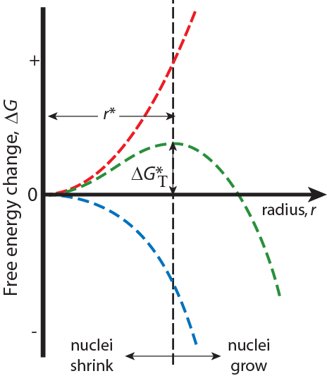
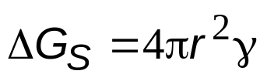
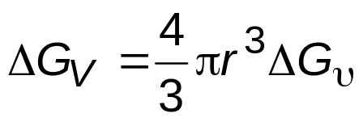
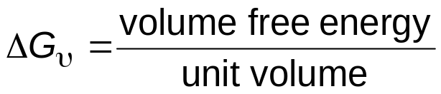
Homogeneous Nucleation
Surface Free Energy- destabilizes
the nuclei (it takes energy to make
an interface)
γ = surface tension
ΔG_{T} = Total Free Energy
= ΔG_{S} + ΔG_{V}
Volume (Bulk) Free Energy –
stabilizes the nuclei (releases energy)
r* = critical nucleus: nuclei < r* shrink; nuclei>r* grow (to reduce energy)

Slide 7
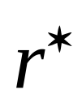
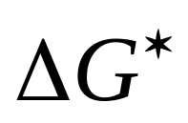
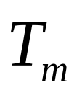
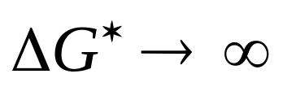
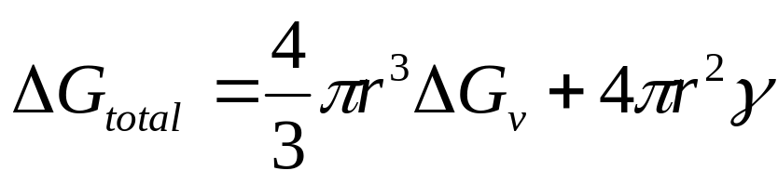
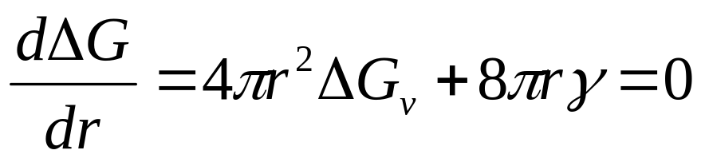
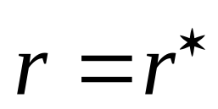
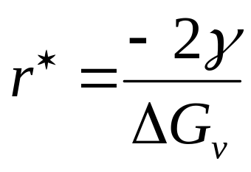
Both
and
are functions of temperature.
Cannot get nucleation at
since
Since
at maximum ΔG (i.e.
)
or

Slide 8


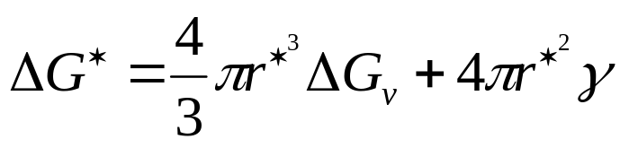
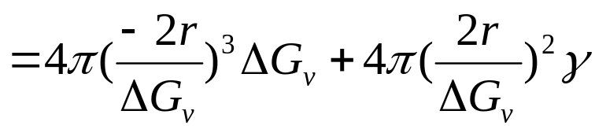
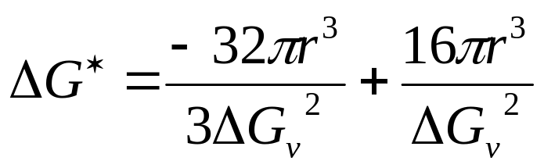
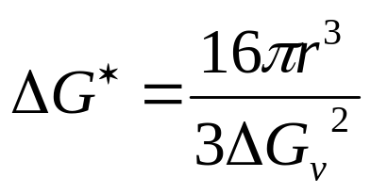

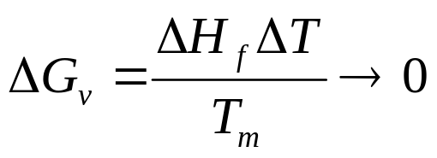

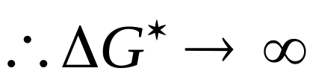


If the surface energy γ is small, and
is large , then
will be small.
Thus
critical amount of energy to form a nucleus of a radius
T→
Thus
increase as approaching

Slide 9
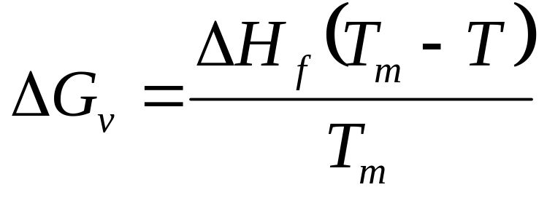
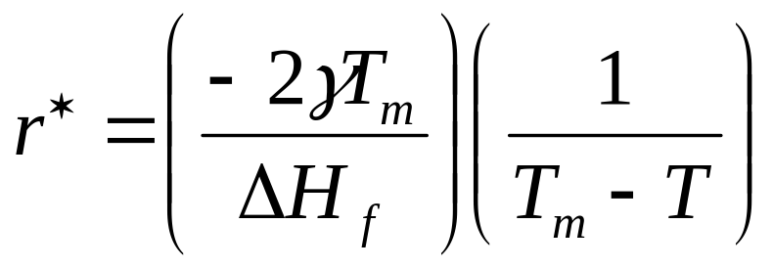
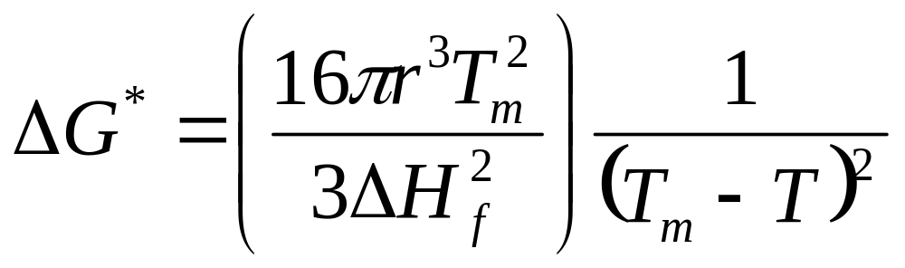

Slide 10
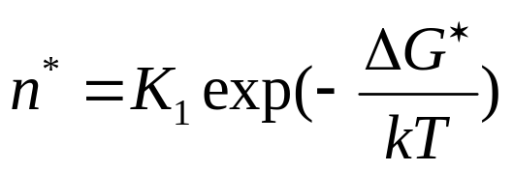
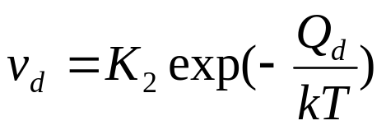
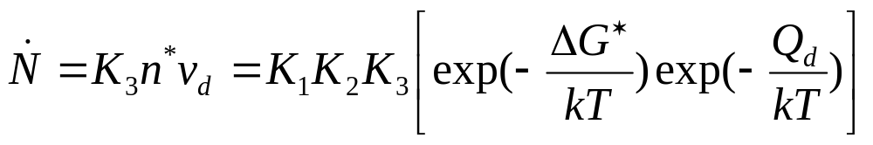
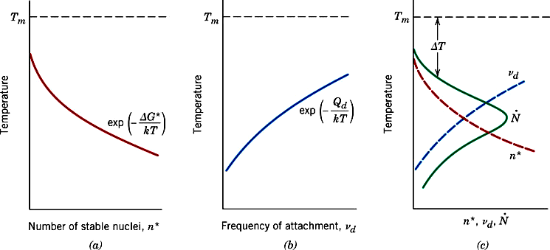
Stable nuclei n*
(radii greater than r*)
Frequency of attachment v_{d}
Nucleation rate

Slide 11
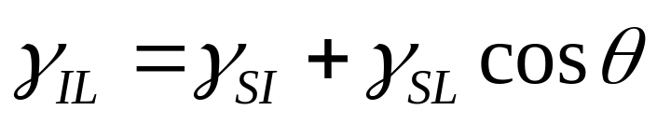
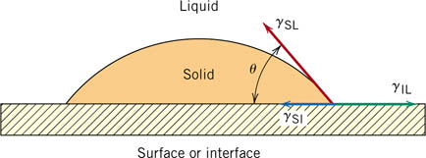
Heterogeneous nucleation

Slide 12
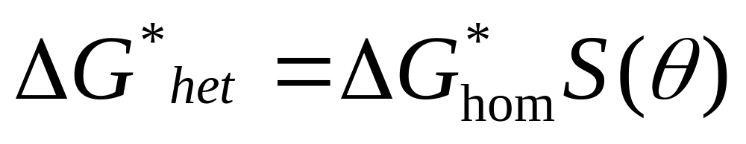
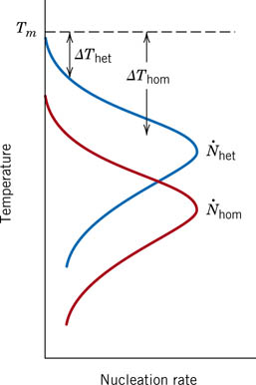
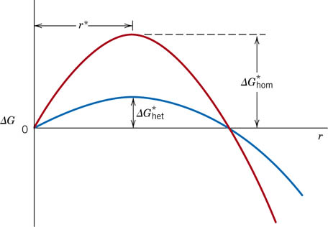
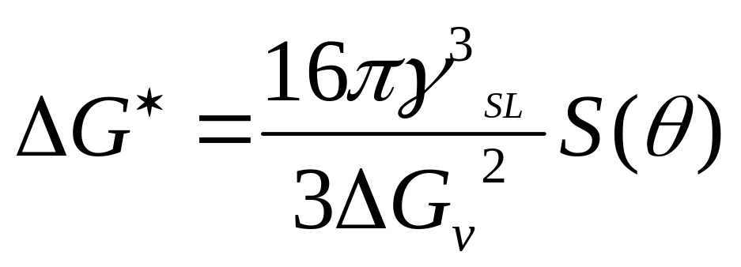

Slide 13
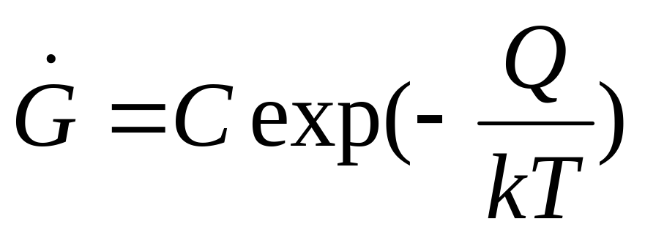
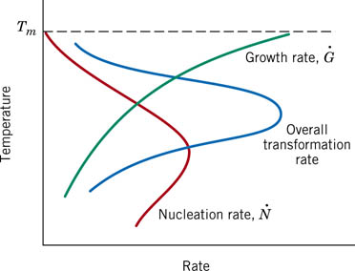
Growth rate

Slide 14
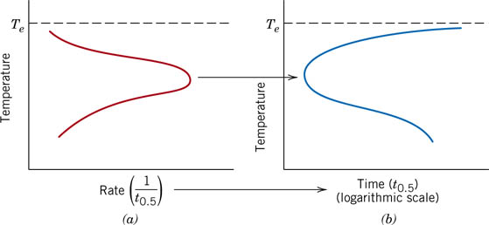

Slide 15
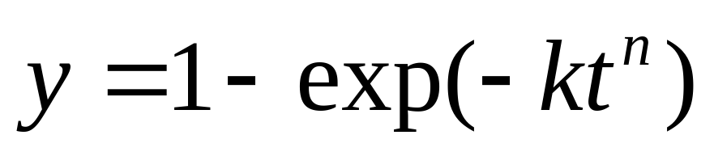
S-shape curve: percent of material transformed vs. the logarithm of time.

Slide 16
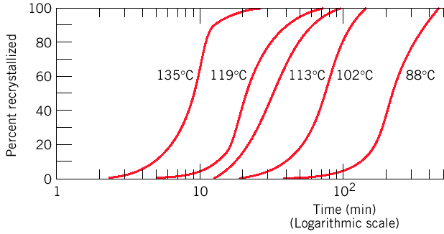
Rate of phase transformations
Rate = Reciprocal of time halfway to completion:
r = 1 / t_{0.5}
Arrhenius equation: thermally activated processes: r = A exp (-Q_{A}/kT) = A exp (-Q_{m}/ RT)
Per atom
Per mole
Percent recrystallization of pure copper at different T

Slide 17
Superheating / supercooling
Crossing phase boundary → new equilibrium state
Takes time ⇒ transformation is delayed
During cooling, transformations occur at temperatures less than predicted by phase diagram: supercooling.
During heating, transformations occur at temperatures greater than predicted by phase diagram: superheating.
Degree of supercooling/superheating increases with rate of cooling/heating.
Microstructure is strongly affected by the rate of cooling.

Slide 18
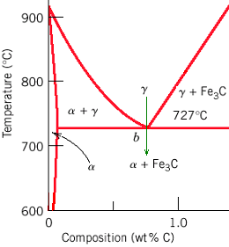
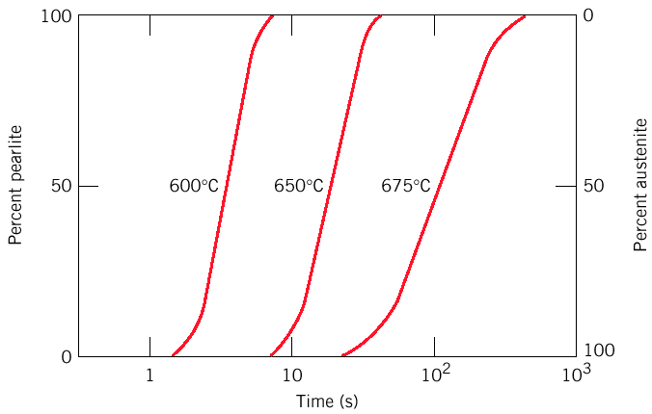
Eutectoid reaction: example
eutectoid reaction:
γ(0.76 wt% C)
↓
α (0.022 wt% C)
+
Fe₃C
Higher T→ S-shaped curves shifted to longer times ⇒ transformation dominated by nucleation (rate increases with supercooling) and not by diffusion (occurs faster at higher T).

Slide 19
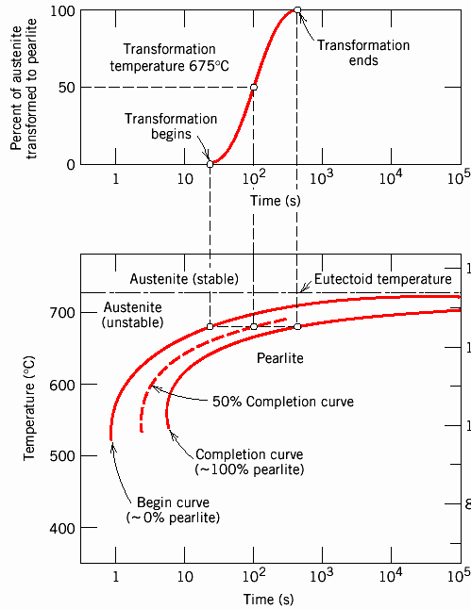
Isothermal Transformation (or TTT) Diagrams
(Temperature, Time, and % Transformation)

Slide 20
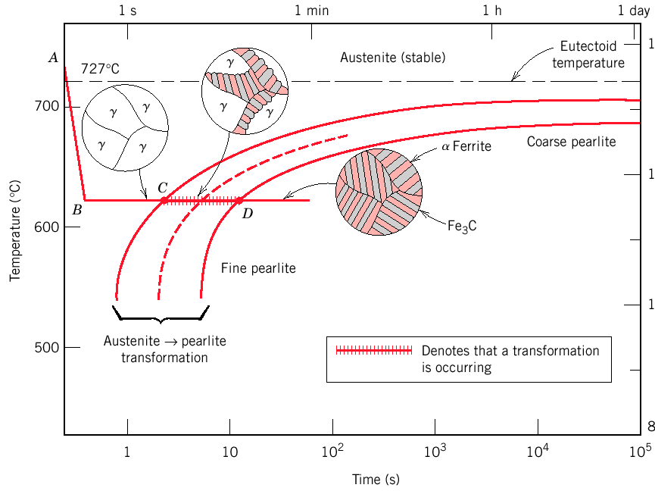
TTT Diagrams
Eutectoid
temperature
Austenite (stable)
α ferrite
Coarse pearlite
Fe₃C
Fine pearlite
Austenite → pearlite
transformation
Denotes that a transformation
is occurring
Thickness of ferrite and cementite layers in pearlite is ~ 8:1. Absolute layer thickness depends on temperature of transformation.
Higher temperature → thicker layers.

Slide 21
TTT Diagrams
Family of S-shaped curves at different T
Isothermal (constant T) transformation → material is cooled quickly to T THEN transformation occurs)
Low T → Transformation occurs sooner (controlled by rate of nucleation). Grain growth reduced (controlled by diffusion)
Slow diffusion leads to fine grains + thin- layers (fine pearlite)
High T → diffusion rates allow for larger grain growth + formation of thick layers
(coarse pearlite)
Compositions other than eutectoid, proeutectoid phase (ferrite or cementite) coexists with pearlite.

Slide 22
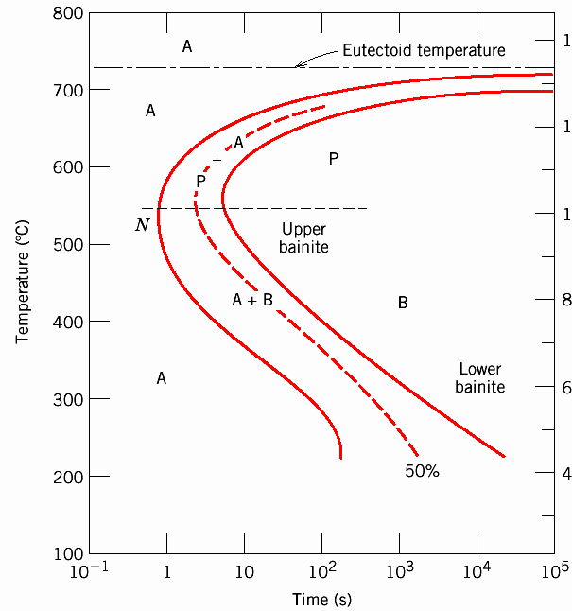
Formation of Bainite Microstructure
Transformation T low enough (≤540°C)
Bainite rather than fine pearlite forms

Slide 23
Formation of Bainite Microstructure
T ~ 300-540°C, upper bainite consists of needles of ferrite separated by long cementite particles
T ~ 200-300°C, lower bainite has thin plates of ferrite and fine rods or blades of cementite
Bainite: transformation rate controlled by microstructure growth (diffusion) rather than nucleation. Diffusion is slow at low T, It has a very fine (microscopic) microstructure.
Pearlite and bainite transformations are competitive.

Slide 24
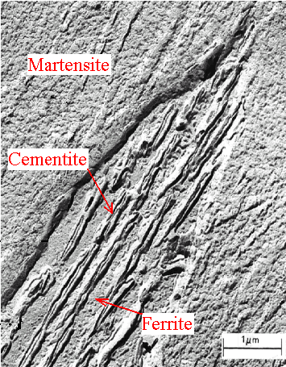
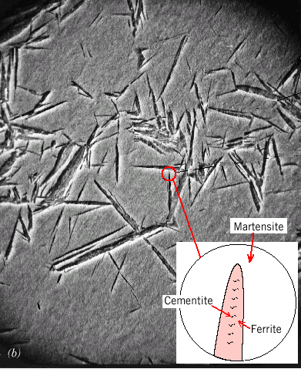
Upper bainite
Lower bainite

Slide 25
Spheroidite
Annealing of pearlitic or bainitic at T just below eutectoid (e.g. 24h at 700C) forms spheroidite - Spheres of cementite in a ferrite matrix.
Relative amounts of ferrite and cementite do not change, only shape of cementite inclusions changes
Transformation proceeds by C diffusion – needs high T.
Driving force – reduction in total ferrite - cementite boundary area

Slide 26
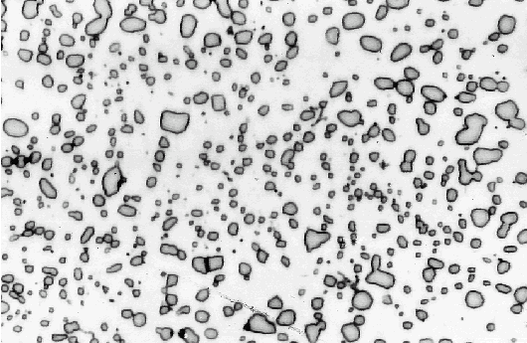

Slide 27
Martensite
Martensite:austenite quenched to room T
Nearly instantaneous at required T
Austenite →martensite does not involve diffusion → no activation: athermal transformation
Each atom displaces small (sub-atomic) distance to transform FCC γ-Fe (austenite) to martensite, a Body Centered Tetragonal (BCT) unit cell (like BCC, but one unit cell axis longer than other two)
Martensite is metastable - persists indefinitely at room T: transforms to equilibrium phases on at elevated temperature
Martensite can coexist with other phases and microstructures
Since martensite is a metastable phase, it does not appear in phase Fe-C phase diagram

Slide 28
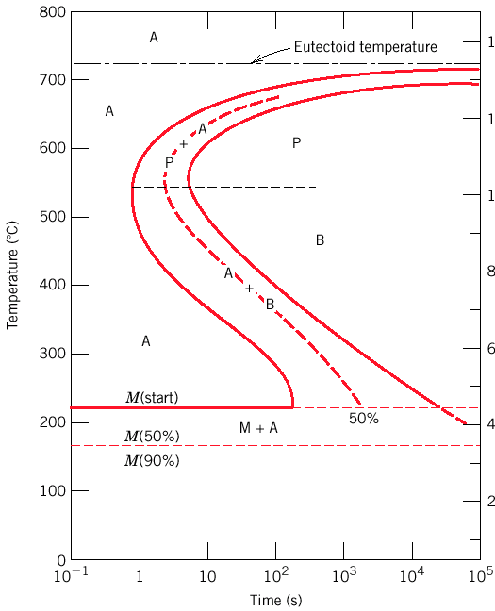
TTT Diagram including Martensite
Austenite-to-martensite is diffusionless and fast.
Amount of martensite depends on T only.
A: Austenite P: Pearlite
B: Bainite M: Martensite

Slide 29
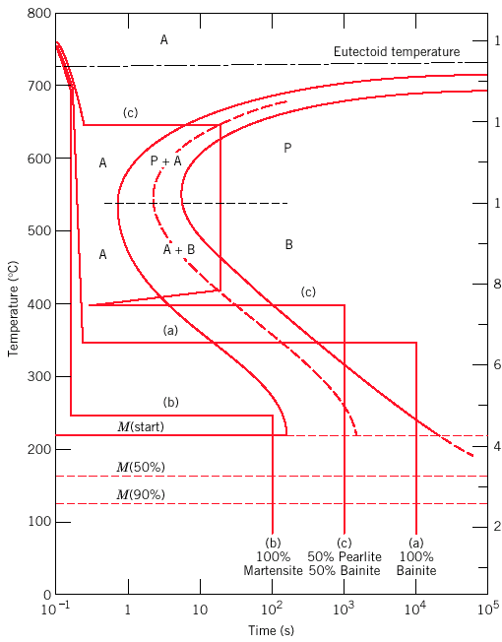
Time-temperature path – microstructure

Slide 30
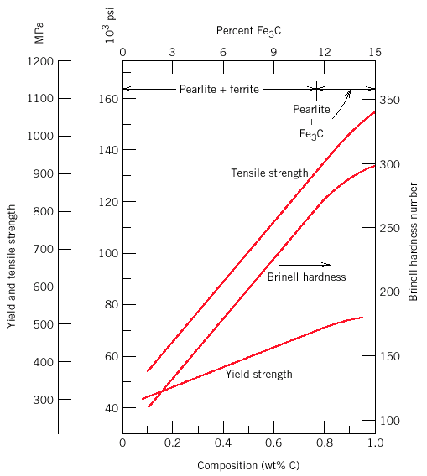
Mechanical Behavior of Fe-C Alloys
Cementite is harder and more brittle than ferrite - increasing cementite fraction makes harder, less ductile material.

Slide 31
Strength and hardness inversely related to the size of microstructures (fine structures have more phase boundaries inhibiting dislocation motion).
Bainite, pearlite, spheroidite
Considering microstructure we can predict that
Spheroidite is softest
Fine pearlite harder + stronger than coarse pearlite
Bainite is harder and stronger than pearlite

Slide 32
Martensite
Of the various microstructures in steel alloys
Martensite is the hardest, strongest BUT most brittle
Strength of martensite not related to microstructure; related to the interstitial C atoms hindering dislocation motion (solid solution hardening) and to the small number of slip systems.

Slide 33


Mechanical Behavior of Fe-C Alloys

Slide 34
Tempered Martensite
Martensite is so brittle it needs to be modified for practical applications. Done by heating to 250-650 ºC for some time: (tempering) →
tempered martensite, extremely fine-grained, well dispersed cementite grains in a ferrite matrix.
Tempered martensite is more ductile
Mechanical properties depend upon cementite particle size: fewer, larger particles means less boundary area and softer, more ductile material - eventual limit is spheroidite.
Particle size increases with higher tempering temperature and/or longer time (more C diffusion).

Slide 35

Higher temperature & time: spheroidite (soft)

Slide 36

Electron micrograph of tempered martensite

Slide 37
Summary of austenite transformations
Austenite
Slow
cooling
Rapid
quench
Moderate
cooling
Pearlite (α + Fe₃C) + a proeutectoid phase
Bainite
(α + Fe₃C)
Martensite
(BCT phase)
Reheat
Solid lines are diffusional transformations, dashed is diffusionless martensitic transformation
Tempered martensite
(α + Fe₃C)

Slide 38
Using the isothermal transformation diagram for a 1.13% wt carbon-iron alloy, determine the nature of the final microstructure (in terms of just the microconstituents present) of a small specimen that has been subjected to the following time-temperature treatments. In each case assume that the specimen begins at 920℃and that it has been held at this temperature long enough to have achieved a complete and homogeneous austenitic structure.
  (a) Rapidly cool to 250℃, hold at this temperature for 1000 s, then quench to room temperature.
  (b) Rapidly cool to 775℃, hold for 500 s, then quench to room temperature.
  (c) Rapidly cool to 400℃, hold for 500 s, then quench to room temperature.
  (d) Rapidly cool to 700℃, hold at this temperature for 100000 s, then quench to room temperature.

Slide 39
(e) Rapidly cool to 650℃, hold at this temperature for 3 s,
rapidly cool to 400℃, hold for 25s, then quench to room
temperature.
(f) Rapidly cool to 350℃, hold for 300 s, then quench to room
temperature.
(g) Rapidly cool to 675℃, hold for 7 s, then quench to room
temperature.
(h) Rapidly cool to 600℃, hold at this temperature for 7 s,
rapidly cool to 450℃, hold at this temperature for 4 s, then
quench to room
temperature.

Slide 40


Slide 41


